Slide 1
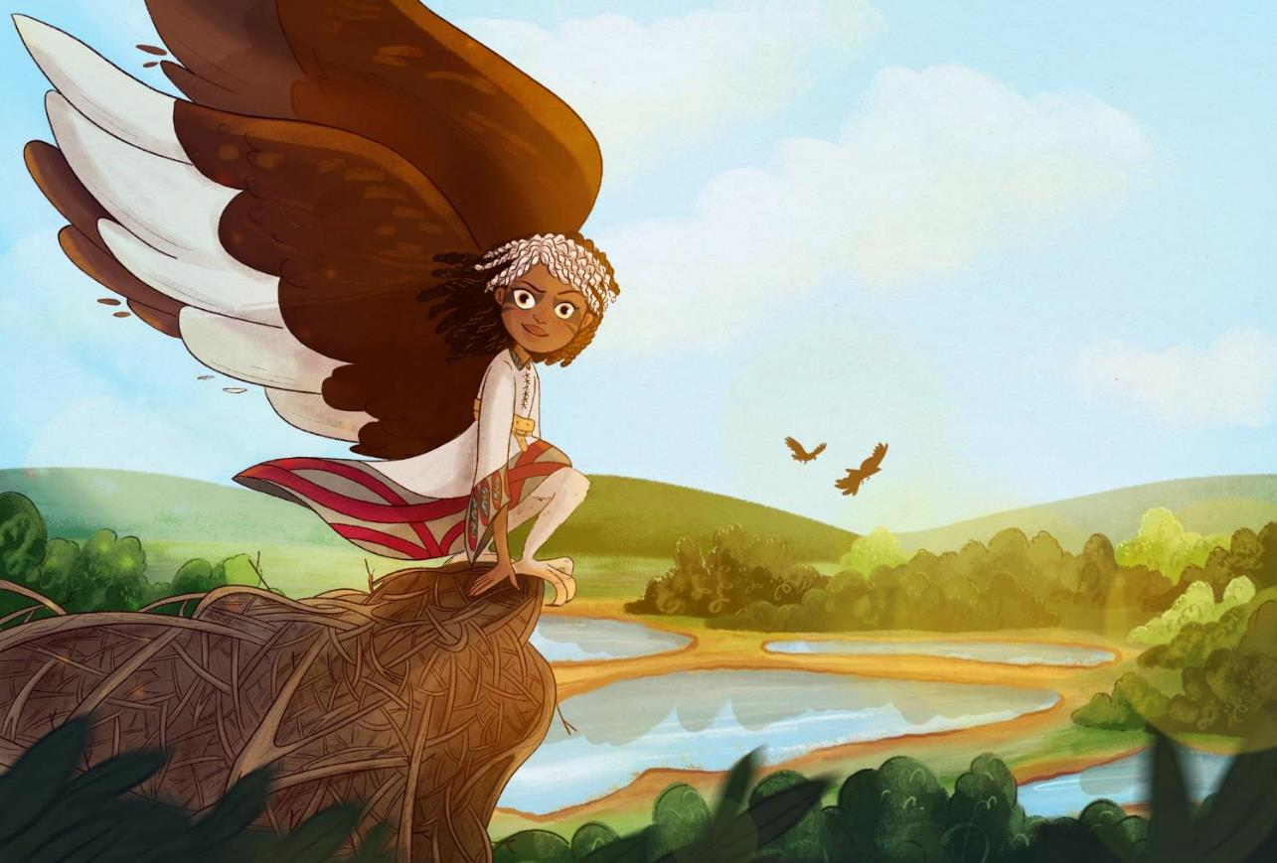

Generation Wild Teacher Briefing
Notes:
Hello everyone, I'm Hiba Hussein, Programme Manger for Generation World at WWT, the UK’s largest wetland restoration charity. I'm delighted to present to you the teacher briefing for Generation Wild

Slide 2
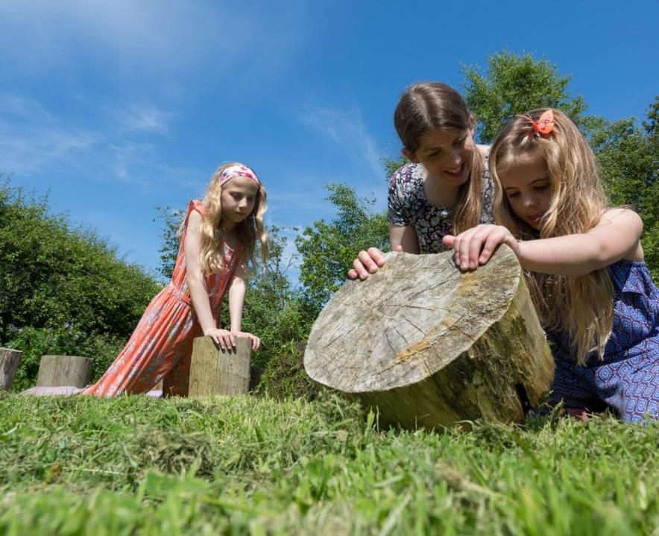

What we will cover:
Before the visit
During the visit
After the visit
Please click this for links
Notes:
This session will give you all the information you need to complete the project successfully with your class. It is broken up into three main sections explaining what you need to do before, during and after your visit.

Slide 3

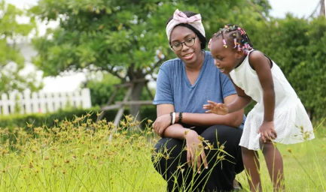
Why did we create Generation Wild?
Notes:
So what is Generation Wild and why did we develop it?
It is a nature connection project for primary schools in underserved areas. The project involves a visit to our centre which acts as the springboard to further activity at school and at home.
The programme was developed because we recognised that children are becoming increasingly disconnected from nature. This is particularly the case for children from underserved communities and we believe that these children also have the most to gain.
Connecting with nature is so important because it has been shown to improve children’s physical and mental health, help them regulate their behaviour, make them feel happier and increase their self-esteem and resilience.
It has also been shown to improve their motivation and their learning.
The programme can also be particularly powerful for children with Special Educational Needs, including those who are neurodiverse.
This is why it so important that the children are supported in completing the nature activities following their visit to the wetland centre. All children should be able to feel these benefits, no matter who they are or where they live and, together we can make that happen.

Slide 4
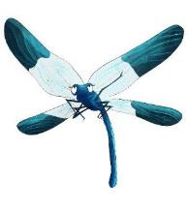

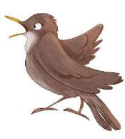
Before your visit
Notes:
Before your visit, there are a few things to do. Don’t worry – it’s really simple.

Slide 5

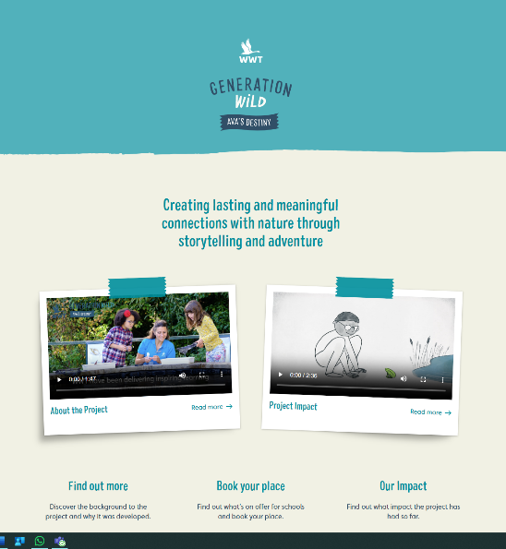
Before your visit
Using the project website
Notes:
First, We’ll set up your school on the website. You’ll receive an invite to log in for the first time and on subsequent visits, the log-in button can be found at the top right of the screen. You need to log in to access all the features of the programme. Once in -
You will be able to:
Add pupils and generate passwords for them
View different nature connection activities
And Track pupils progress completing different activities…. (We will show you why this is important later in the presentation)
The website is a key part of the project and the way in which we can demonstrate children’s engagement with the project, which is vital for our ongoing funding

Slide 6

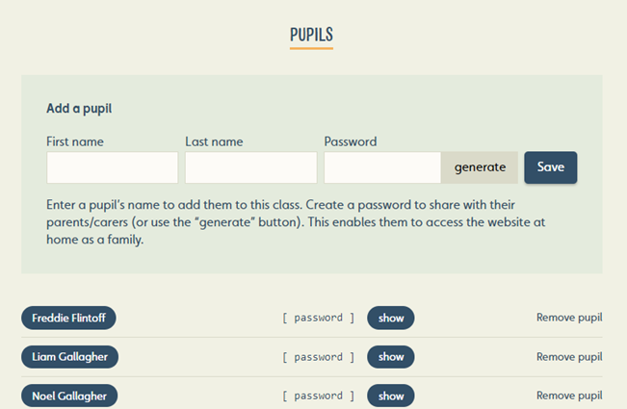
Before your visit
Using the project website
Notes:
Before your visit there are 3 key tasks on the website
Set up your class
Get the children to complete the ‘Before visit’ survey
3) Read Ava’s story to the children
Setting up log-ins for your pupils doesn’t take long and passwords are automatically generated.
Please set these up as soon as possible before your visit.
Please make sure all teachers whose classes are taking part are set up and ready to use the website. Whole-school participation looks great when we’re reviewing impact and inviting schools back—so supporting each other really helps.

Slide 7
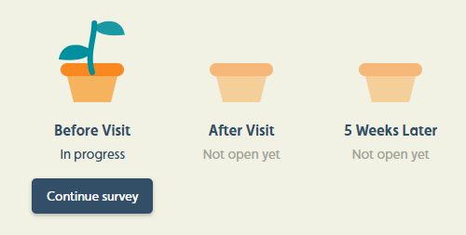
Before your visit
Getting the children to complete the ‘Before visit’ survey
Notes:
As part of the ongoing evaluation of Generation Wild, pupils are asked to complete a short online survey:
* Before the visit
* After the visit
* 5 weeks later
These surveys help us understand whether taking part in Generation Wild is associated with changes in children’s:
• Wellbeing
• Care and connection to nature
This information helps us ensure the programme is working for children and their families, secure future funding and continue to offer the programme free of charge.
The surveys should take no more than 10 minutes to complete. Any teacher whose class complete all three surveys will be entered into a prize draw to win one of several free family memberships, giving you and you family unlimited free access to the wetland centre for a year.
You will receive full instructions for this nearer the time.

Slide 8
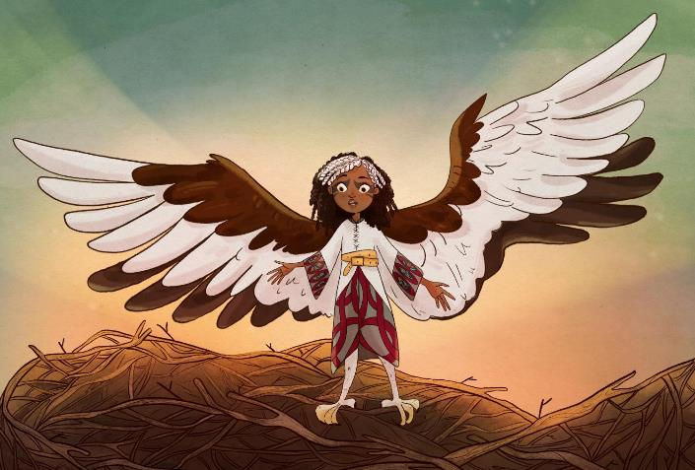
Before your visit
Ava’s story
Notes:
Before your visit we need you to read the story on our website with your class.
Go to the drop down menu and click on “Ava’s Destiny Storybook”.
You can choose to either read the story to them or click on the audio option.
The story introduces Ava, who will play an important role during your school visit. However, please don’t link the story to your upcoming trip or mention Ava or any of the activities to your children. We want to keep this part a surprise. When talking about the visit, simply describe it as a trip to the wetland centre to see some of the animals that live there.

Slide 9
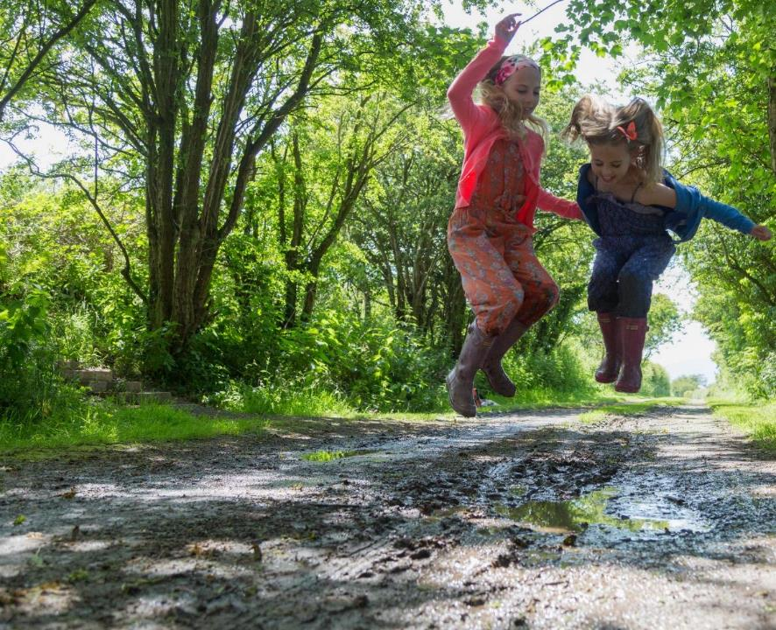

Before your visit
Logistics
Notes:
There are a few things to bear in mind as you prepare for your visit…
Children and accompanying adults will be spending the whole day outdoors so please come dressed and prepared for the weather. If there has been heavy rain, parts of the trail may be a bit muddy. Because the activities promote direct contact with nature, both children and adults may get dirty.
You will find our Risk Assessment on the resources for schools page of the website. If you require any further information to help you ensure a safe visit, please get in touch and we’ll be more than willing to help you.
Generation Wild is delivered through a mix of audio, visual and physical activities. We want Generation Wild to be accessible for all children with all different needs. Please get in touch as soon as possible to let us know if there are any adaptations we should make to ensure that your pupils are able to fully engage.
If you would like to do a teacher pre-visit to the centre you are very welcome. Just get in touch with us.

Slide 10
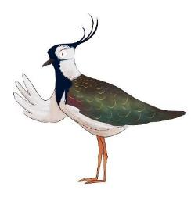
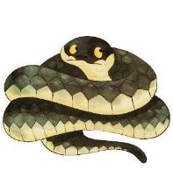
The school visit

Slide 11
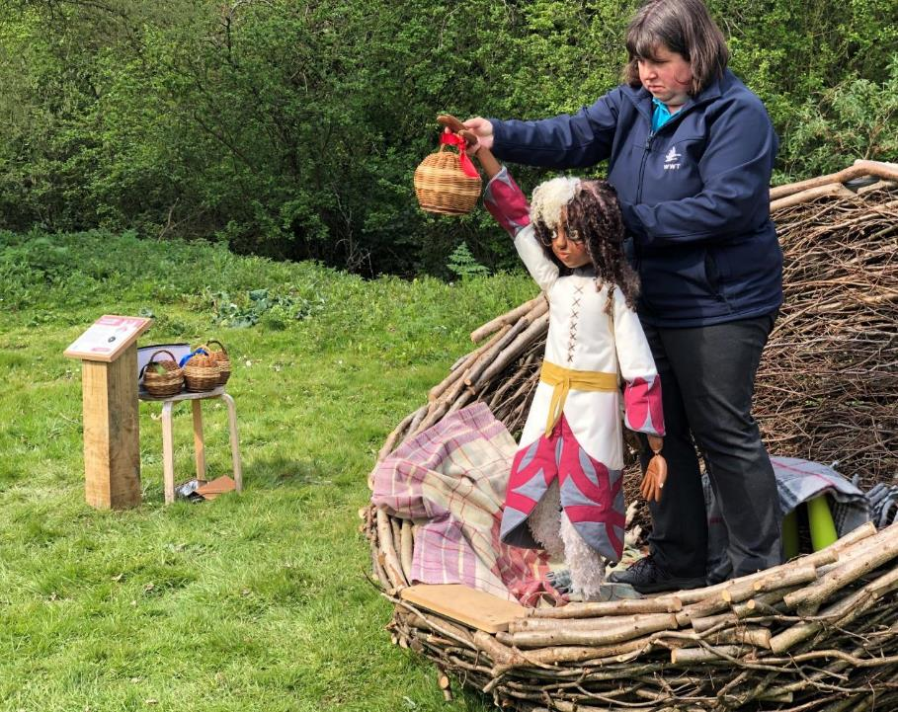
The school visit
Puppet Intro
Notes:
When you arrive at the centre you will be greeted by one of the WWT Team who will help you settle in and show you where to put your bags and where to go to start your Generation Wild Session.
The children will stumble across Ava’s nest. This is meant to be a surprise so please don’t tell them that they are going to meet Ava.
Once at the nest, the Ava puppet performance will start and this lasts about 5 mins. The performance continues the story that was read at school and Ava tells the children about their tasks for the day.
A staff member with then tell you and the children what to do next.

Slide 12
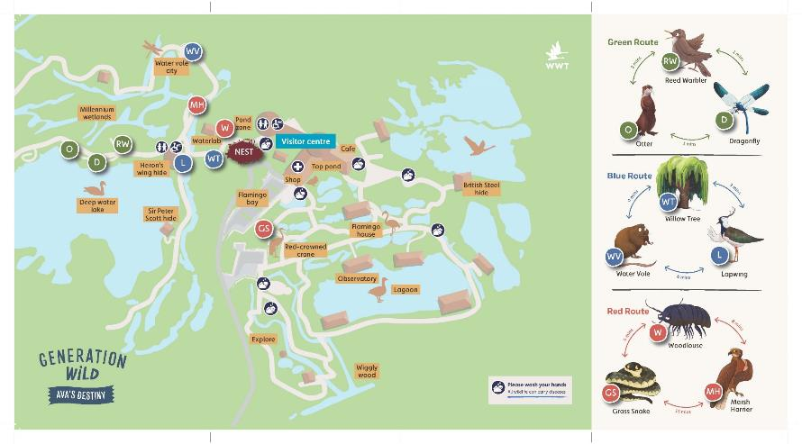
The school visit
Activity trail
Notes:
Your class will split up into groups to complete an activity trail. They will be given a map and a special listening device. Ava calls these her “translatorphones” as they enable children to hear messages from the animals.
It would be very helpful if you could decide on the groups before the visit. We need there to be at least one adult with each group. Ideally groups would be 10 children or less. This is because smaller groups give the children a chance to engage with the project more effectively. However, we appreciate that this might not work with your numbers so we can be flexible. We can have a maximum of 6 groups in total.
The trail usually lasts between 45 and 60 mins and you will be told the time when you need to return to the nest.

Slide 13
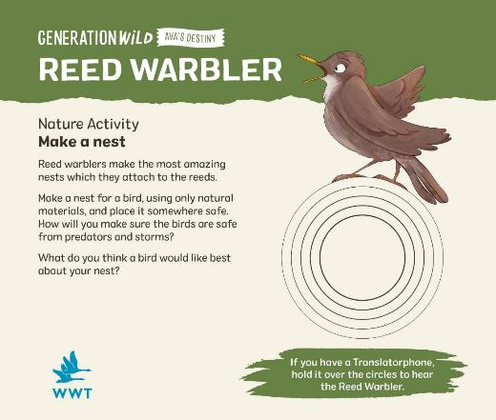
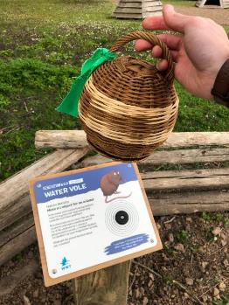
The school visit
Activity trail
Notes:
Each group’s task will be to visit up to 3 listening posts and you will be told which posts you need to find. When you find each one, the children can place the translatorphone onto the post which triggers the audio. The animal will introduce an activity and more detailed instructions can be found on the post itself.
Please read the instructions from the post and set the children off on the activity.
Each activity is designed to connect children to nature in different ways. Some are physical, such as “make a nest for a bird using natural objects”. Others use different senses such as “Close your eyes and count how many different bird sounds you can hear”.
None of the activities require any scientific knowledge or expertise. Its all about how anyone and everyone can connect with nature.

Slide 14
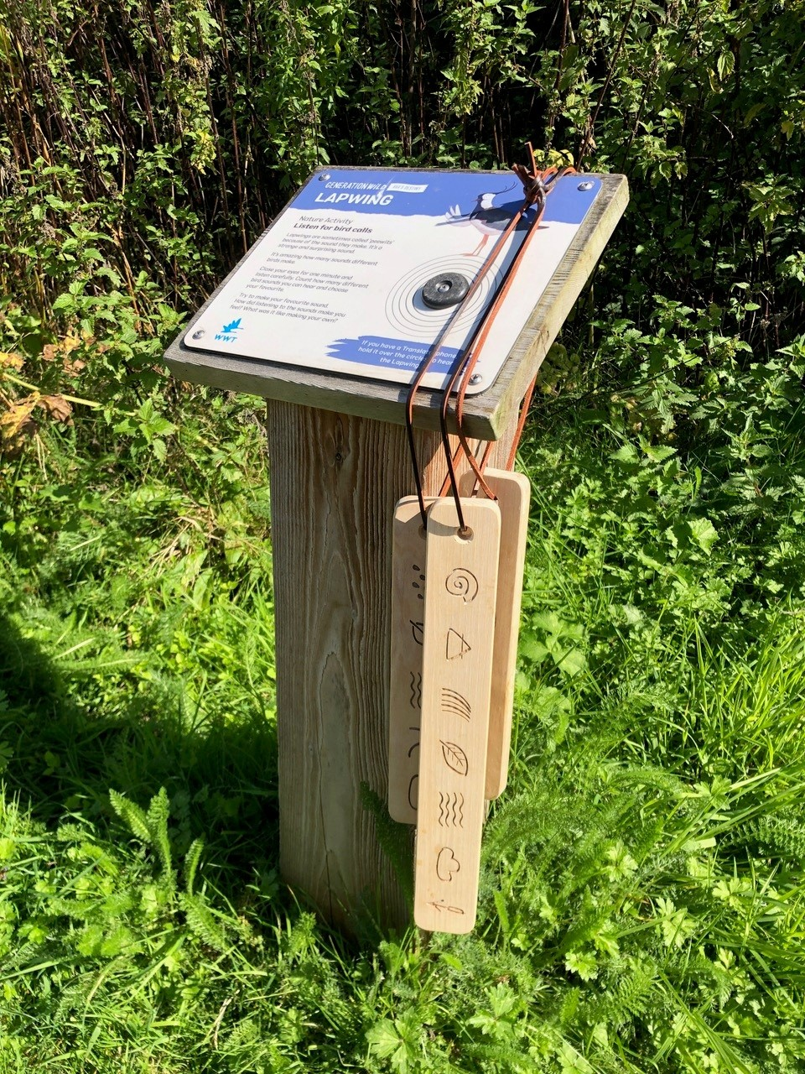
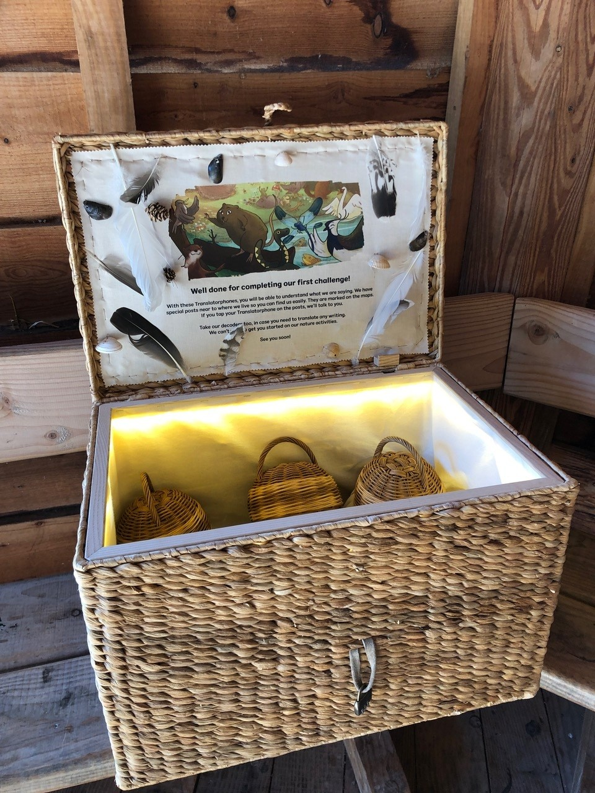
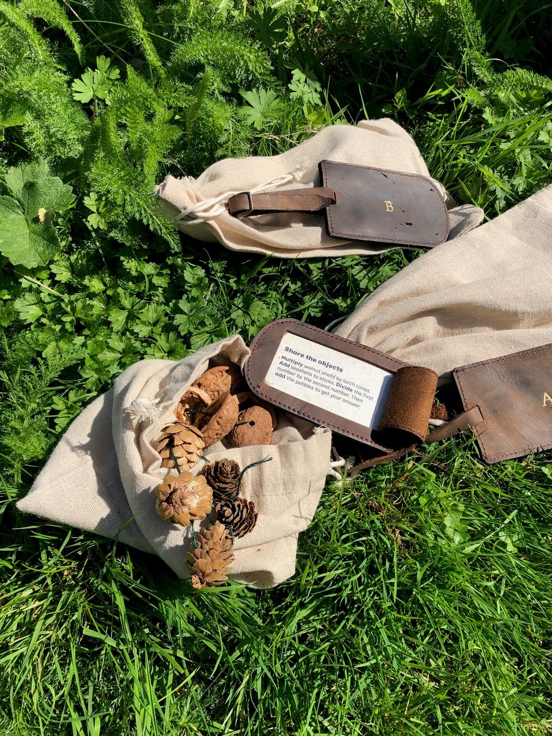
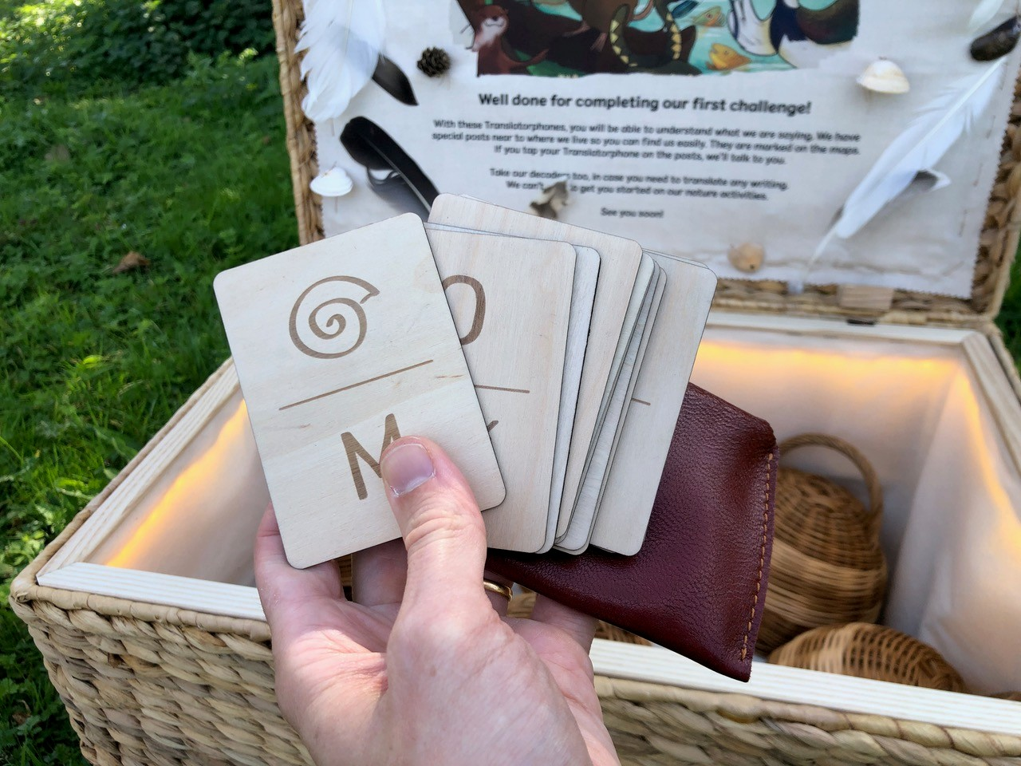
Y4-6 only
Activity trail
Notes:
Now for those of you bringing year four to six classes, we have incorporated some additional code-breaking activities to add more of a challenge. Some of these are literacy related whilst other are numeracy-based.

Slide 15
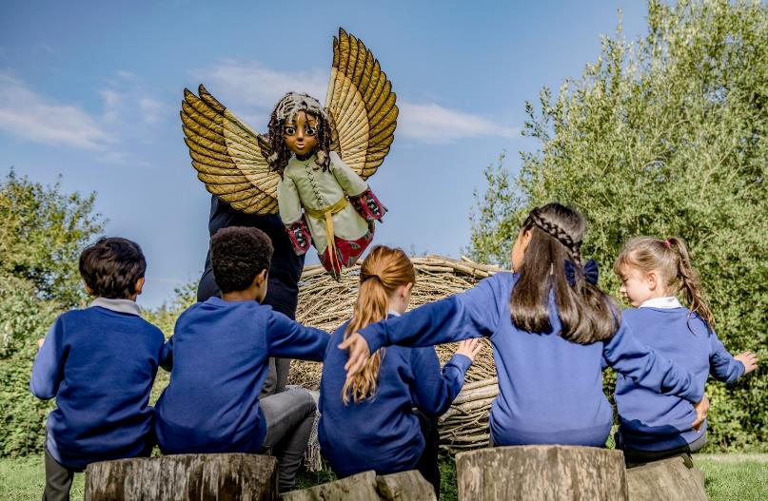
The school visit
Puppet finale
Notes:
Finally, the session wraps up with a final 5 minute puppet performance where Ava encourages the children to complete more nature activities at home and school in order to become ‘Guardians of the Wild’. It ends with Ava disappearing into the distance as she begins her migration.

Slide 16
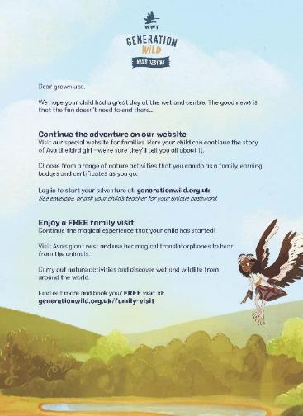
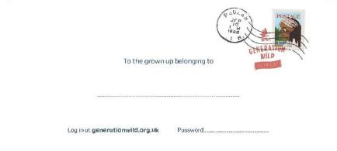
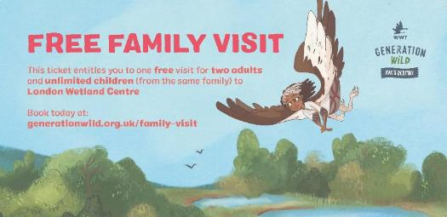
The school visit
Take-home packs
Notes:
At the end of your visit you will be provided with an envelope for each child containing a free family visit ticket and a space for you to write the child’s name and website password. As soon as the password is written on them, please give them to the children so that they can log on to the website.
You will also be provided with Guardians of the Wild certificates and pin badges. Please do not give these out straight away. These are to be awarded to each child once they have completed ten nature connection activities on the Generation Wild website.

Slide 17
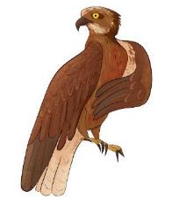
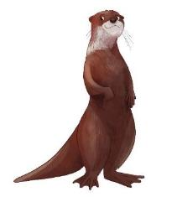
After the visit
Notes:
So now you’re back at your school, and you might be thinking – what’s next?

Slide 18
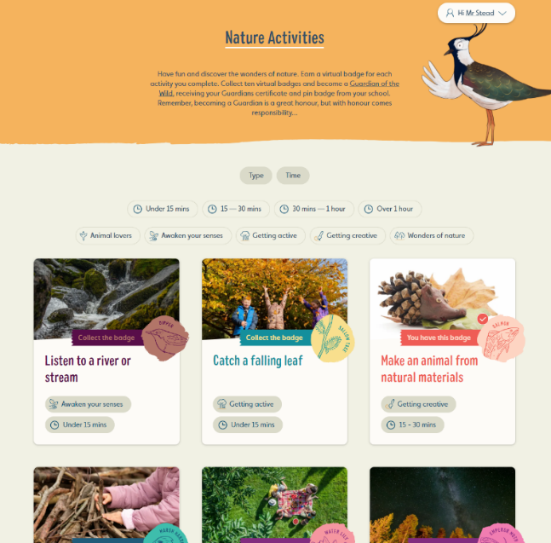
After the visit
Follow up activities
Notes:
Well, previously our learning programme was focussed on one-off school visits with little follow-up back in the local community. Whilst a one off visit is great, we also know that it doesn’t necessarily result in children developing a long-term connection with nature.
This is important because we know that when children do grow this long-term connection it has significant mental health benefits and also leads to children developing a love, care and concern for nature which they often then carry with them throughout their lives.
That’s why doing these activities when you’re back at school, and at home, is so important.

Slide 19
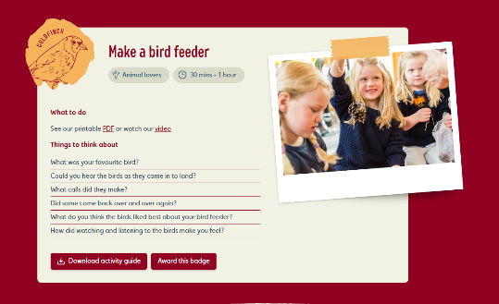
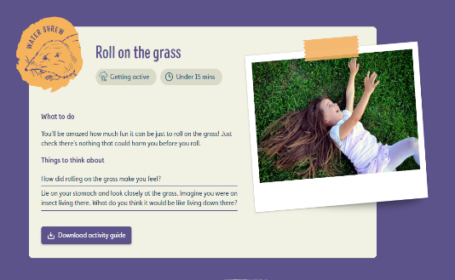
After the visit
Nature activities
Notes:
There are a wide variety of activities. Some take just a few minutes; others can be longer projects. Some simply involve being outside and noticing nature. It should be possible for any child to complete lots of activities regardless of where they live and without any equipment at all.
And if you can complete and record some of the activities at school, particularly if there are children that are facing considerable barriers at home, then that would be even more beneficial.

Slide 20
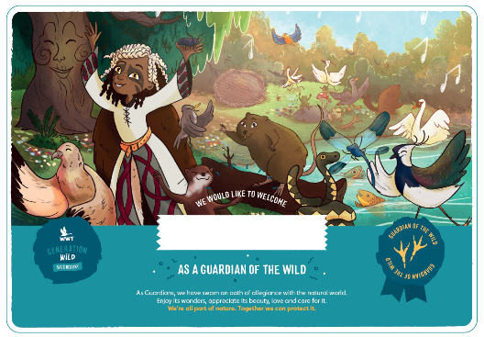
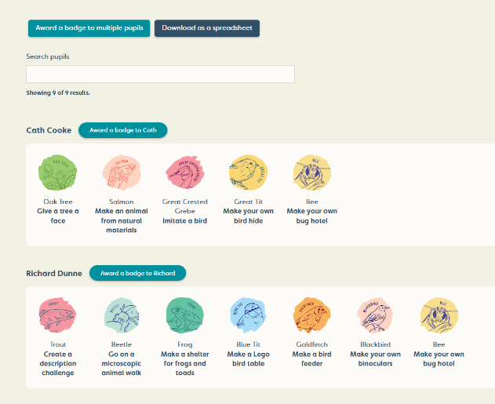
After the visit
Monitoring progress
Notes:
Encouraging pupils to complete the nature activities is the most important part of the project. Please consider tasking some for homework or do some at school with the class. Lots of the activities go hand in hand with the curriculum and could easily be linked in with science, geography and many other aspects required in KS1 and KS2.
All we ask is that you remind the children to document that they have completed an activity. This is because in order to deliver this project free of charge, we have to provide our funders with evidence that children are engaging with nature and benefiting from the project.
Its really reasly and once they have completed 10 activities they become “Guardians of The Wild” since they have demonstrated their commitment to connecting with nature. You will receive an email notification letting you know. It would be great if they could be awarded their badge and certificate in assembly so that their achievement is celebrated.

Slide 21
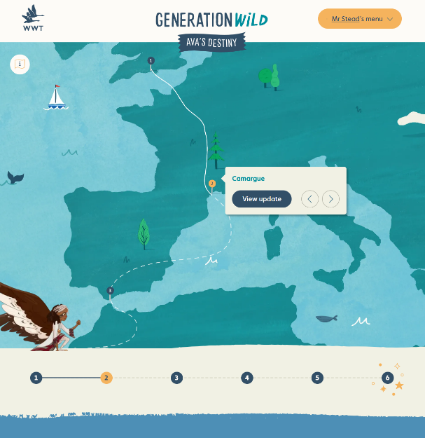
After the visit
Ava’s migration
Notes:
As well as the nature activities, the website also gives children the chance to follow Ava’s migratory journey. There are 5 stops each with their own audio bulletin. The last stop concludes the story in the form of an animation. It really is worth getting to this if you can!

Slide 22
After your visit
Getting the children to complete the ‘After visit’ and ‘Five weeks later’ surveys
Notes:
You will be asked to get your pupils to fill in the ‘After visit’ and ‘5 weeks later’ surveys. These are a repeat of the survey children completed prior to their visit and are designed to track changes in nature connection and wellbeing over time.
Any teacher whose class complete all three surveys will be entered into a prize draw to win one of several free family memberships, giving you and you family unlimited free access to the wetland centre for a year.

Slide 23
Summary
Set pupils up on website
Visit
Encourage children to complete nature activities to become Guardians of The Wild
Read Ava’s story
Give children the website passwords and show them how the website works
Pupils complete ‘Before visit’ survey
Pupils complete ‘After visit’ survey
Pupils complete ‘5 weeks later’ survey
Notes:
So, to recap, the main things to do are:
Read the story
Set pupils up on the website
Visit us!
Give children their passwords and show them the website
Encourage children to complete activities.
We are offering some great prizes for classes who show us how they have connected with nature through the project. There are lots of £500 Muddy faces vouchers to be won for the classes that best demonstrates this connection.

Slide 24
We hope you enjoy taking part!
Notes:
Thanks for taking the time to work through this briefing. If you have any questions, our friendly learning team will be only too happy to help you. We hope you and your class enjoy taking part in Generation Wild ☺

